Slide 1




Hɸu$e ɸf Card$

Slide 2
Grɸup Member$
Guide
MS. SWATI
YAMIN KHAN
ABDURRAHMAN QURESHI
RUMAAN SHAIKH
HAADIYA SAYED

Slide 3
Prɸblem $tatement
Traditional card games depend mostly on luck and offer limited strategic depth. House of Cards is a themed card game that combines numerical risk management with special-action cards from different houses and a bit of luck.
The game supports both human players and AI-controlled bots, allowing solo practice and strategy learning.
Special cards introduce dynamic effects such as doubling values, copying moves, swapping cards, and blocking actions, making gameplay more interactive, competitive, and replayable.

Slide 4
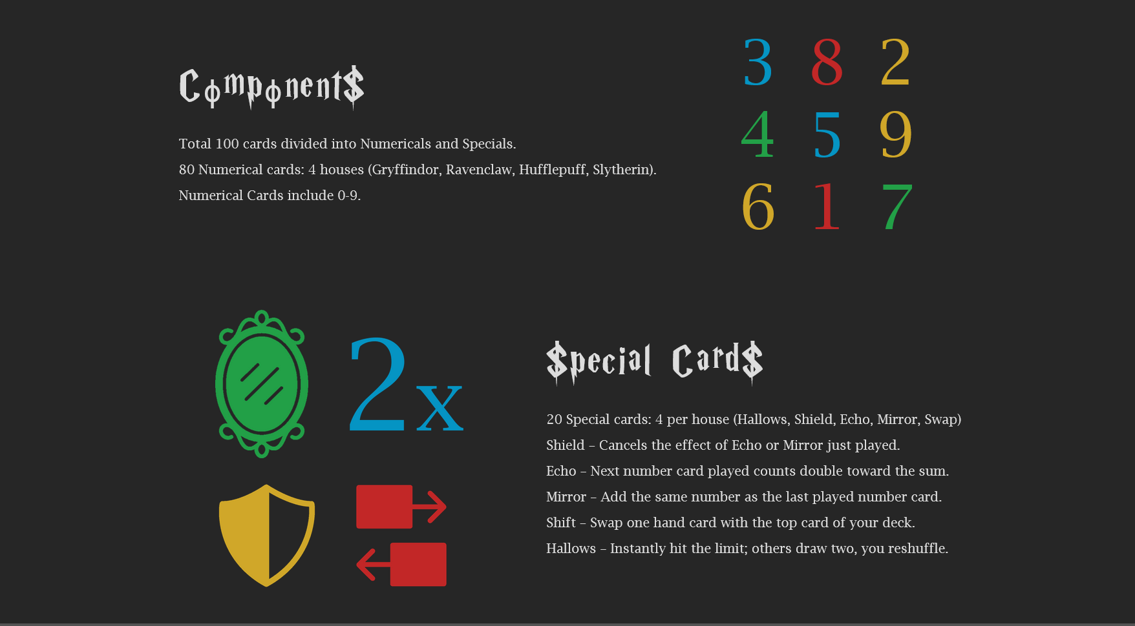

Slide 5
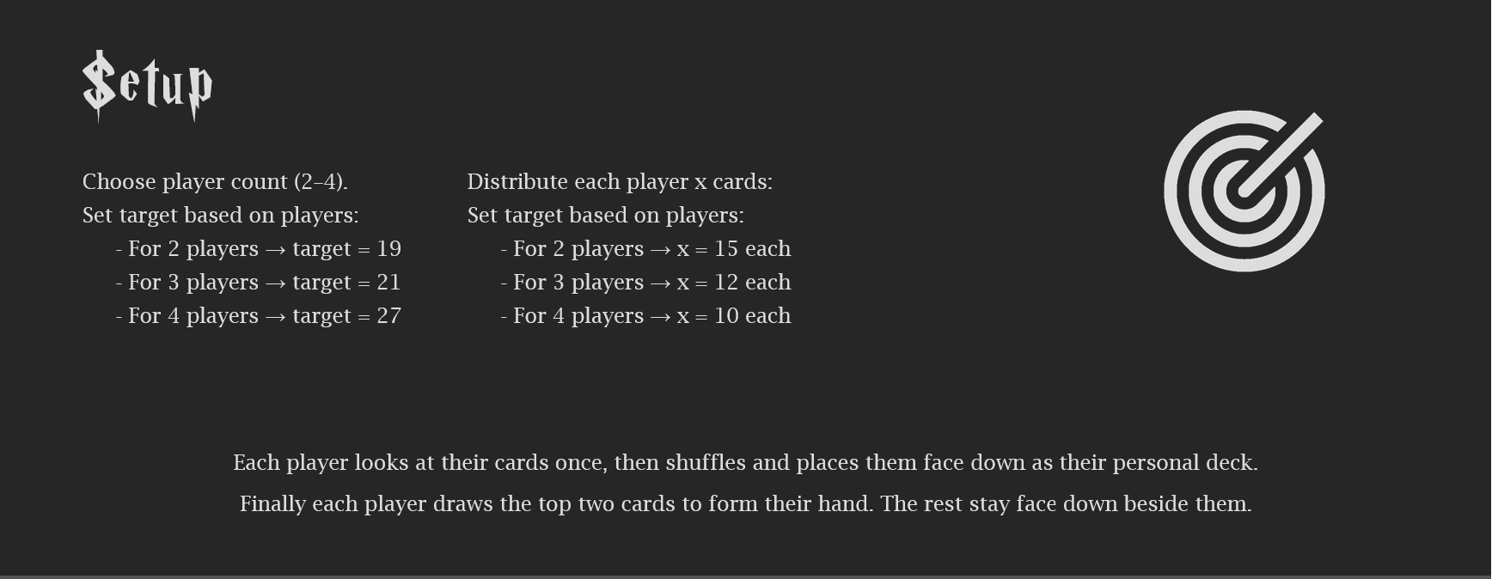

Slide 6
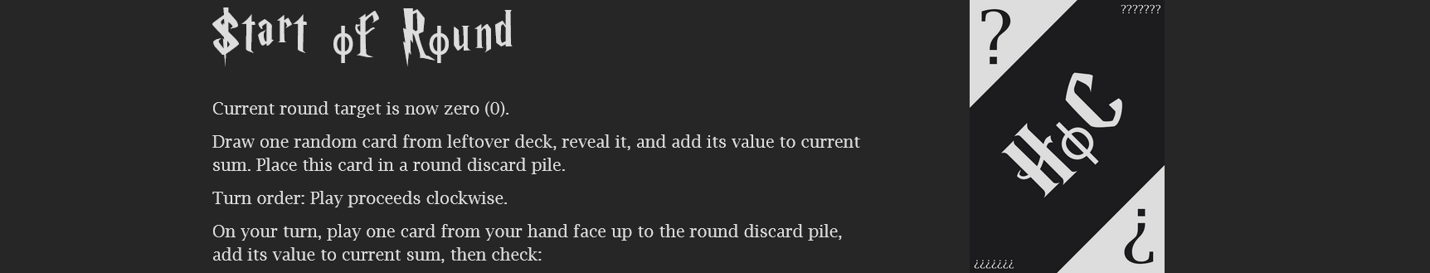

Slide 7
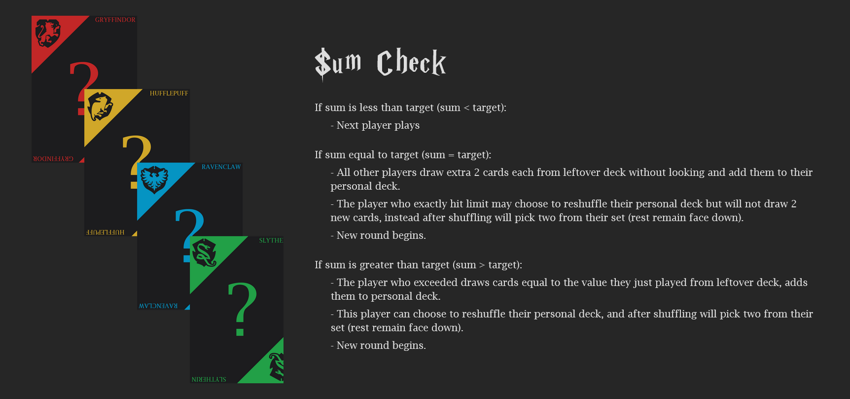

Slide 8
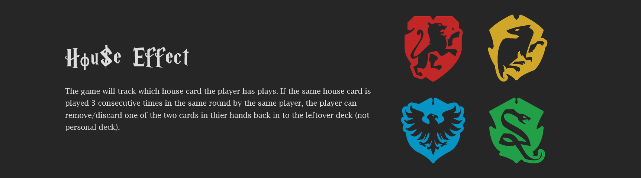

Slide 9
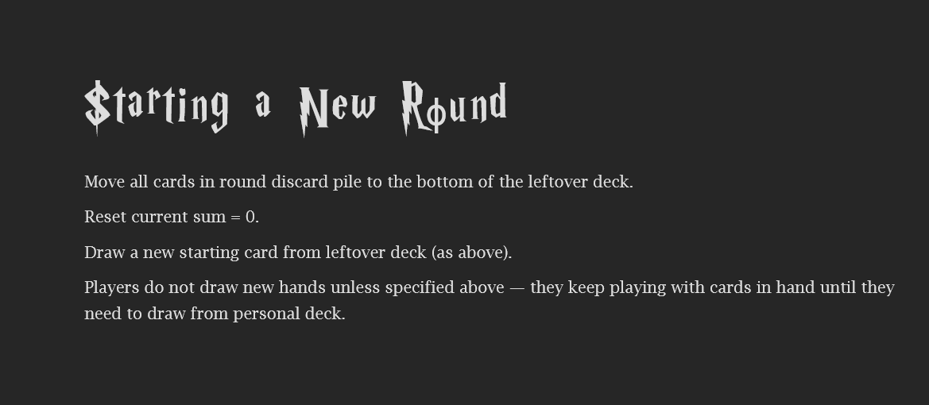




Slide 10


Slide 11
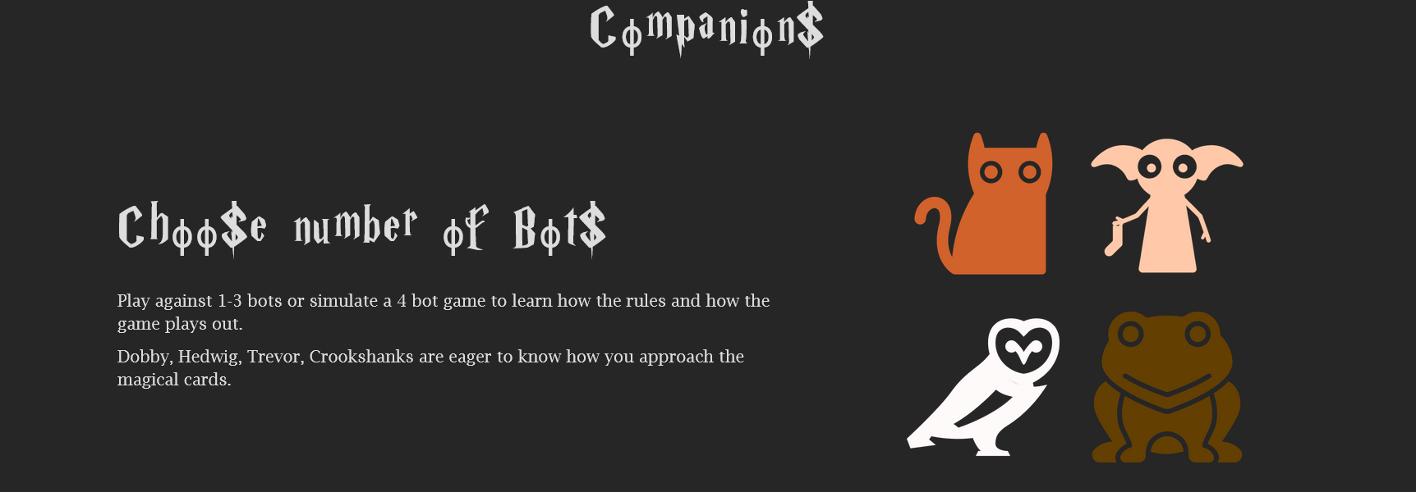

Slide 12

Player Money Model (Real-Money Gameplay)
Wallet System
Players add money to an in-game wallet
Minimum entry amount per match (₹10 / ₹25 / ₹50 etc.)
Paid Matches
Players join cash games by paying an entry fee
Winner(s) receive prize money from the pool
Practice vs Cash Mode
Free mode with virtual coins
Cash mode uses real money for competitive play
We believe in GO BIG OR GO HOME!!!
Gambling was promised to you 3,000 years ago

Slide 13
Thank you

